Slide 1
Water Potability Prediction
Shubham Vishwakarma
Roll no: D023
Sub: Data Engineering

Slide 2
Introduction
This project is dedicated to analyzing and predicting water potability using a dataset that provides a comprehensive look at various chemical characteristics of water samples.
The data comprises 10 different chemical attributes for 3,277 unique water samples.

Slide 3
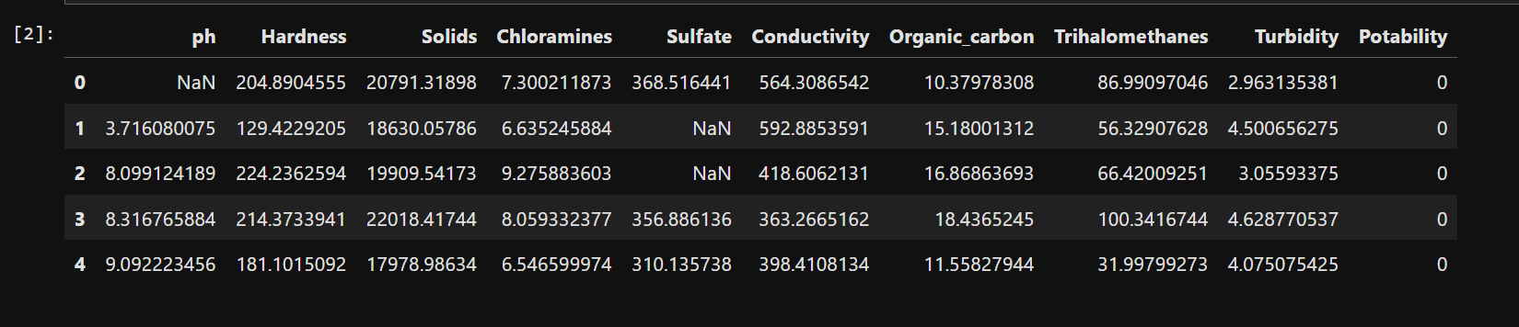
Strategic Plan of Action
Data Undestanding and Exploration
Data Preprocessing
Statistical Analysis
Exploratory Data analysis

Slide 4
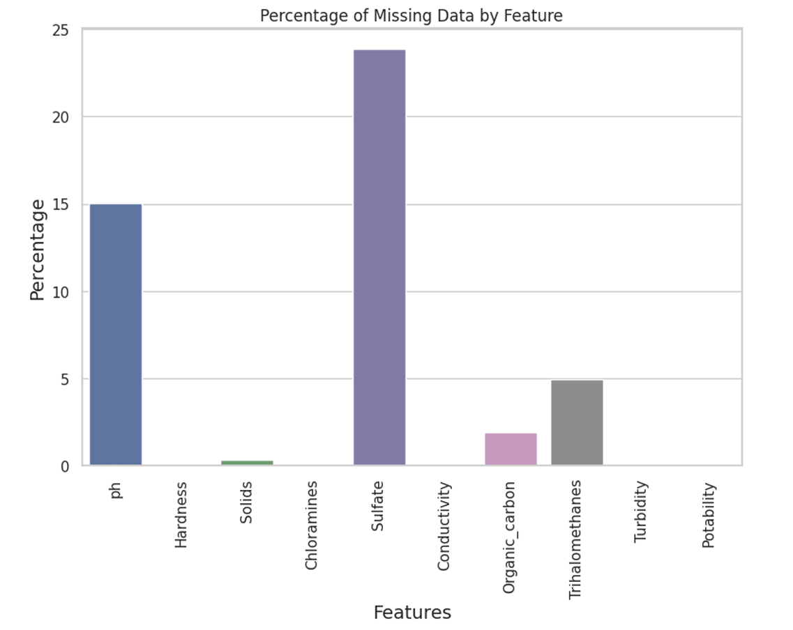
Missing Value

Slide 5
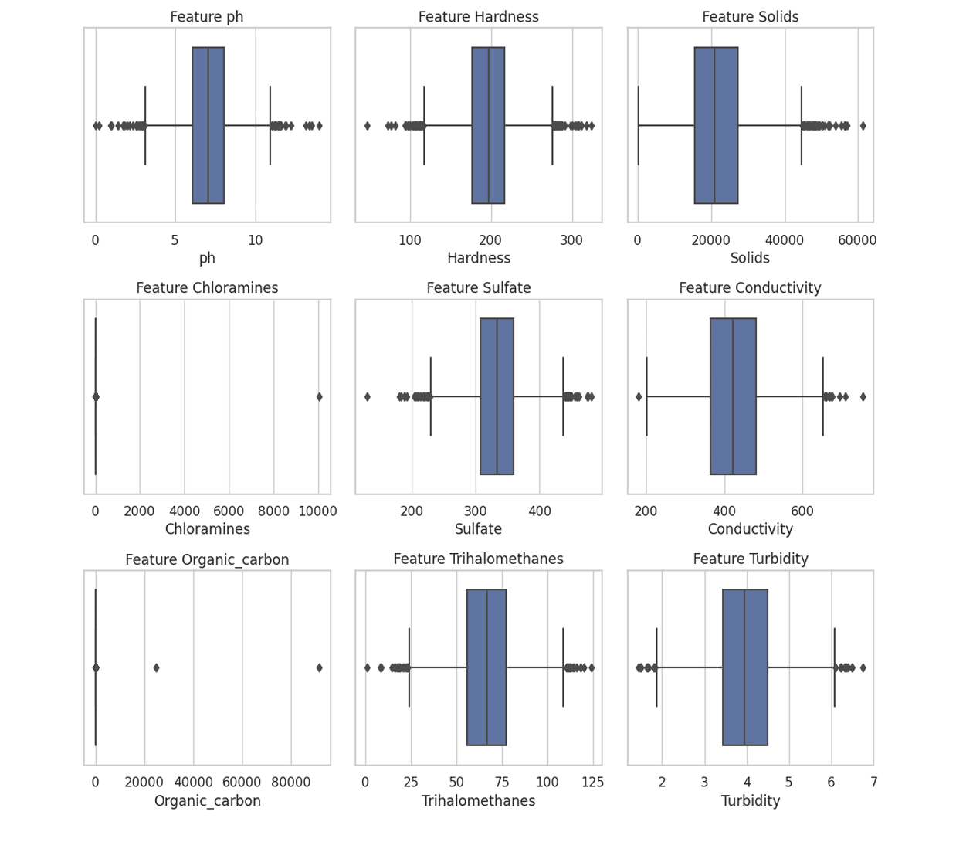
Before:- Noise

Slide 6
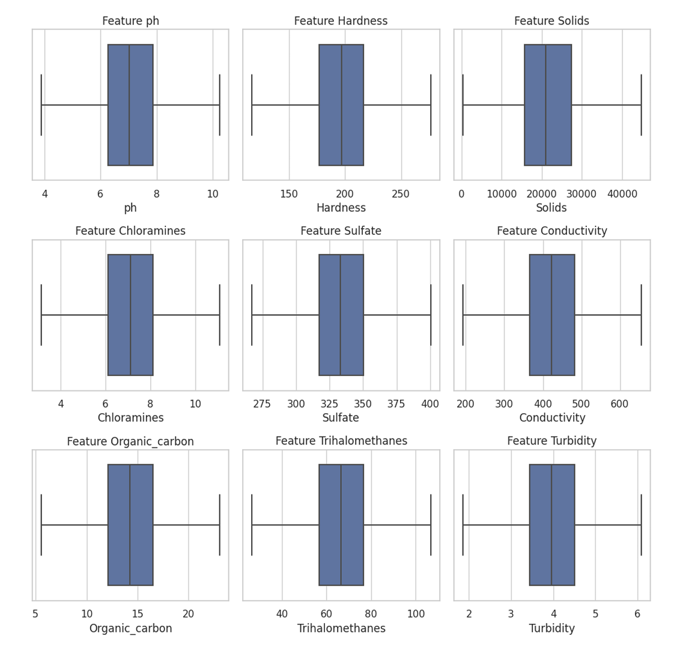
After :- Noise

Slide 7
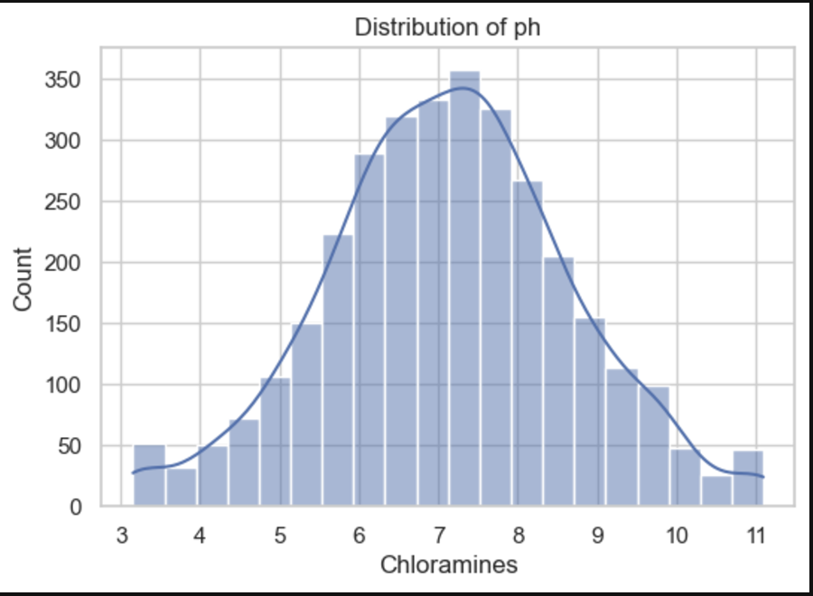
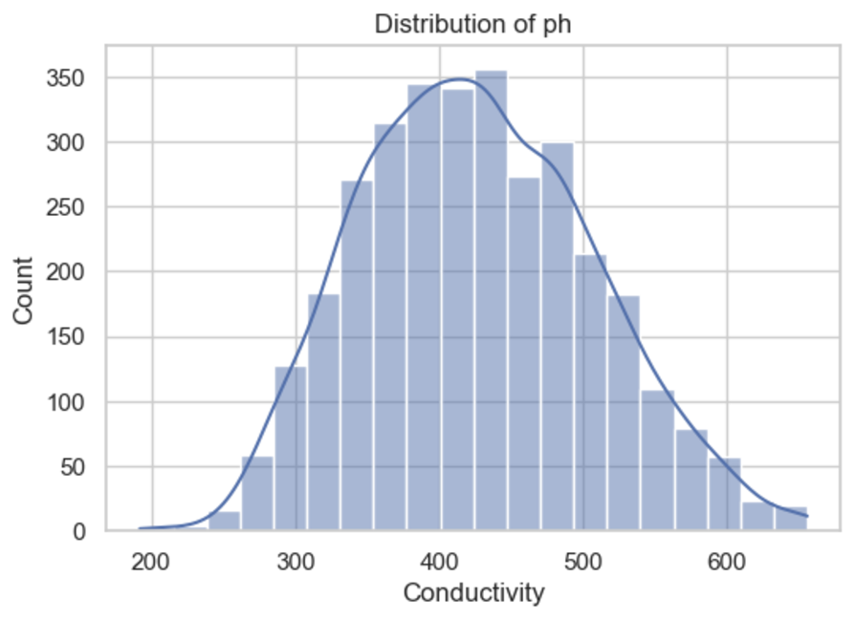
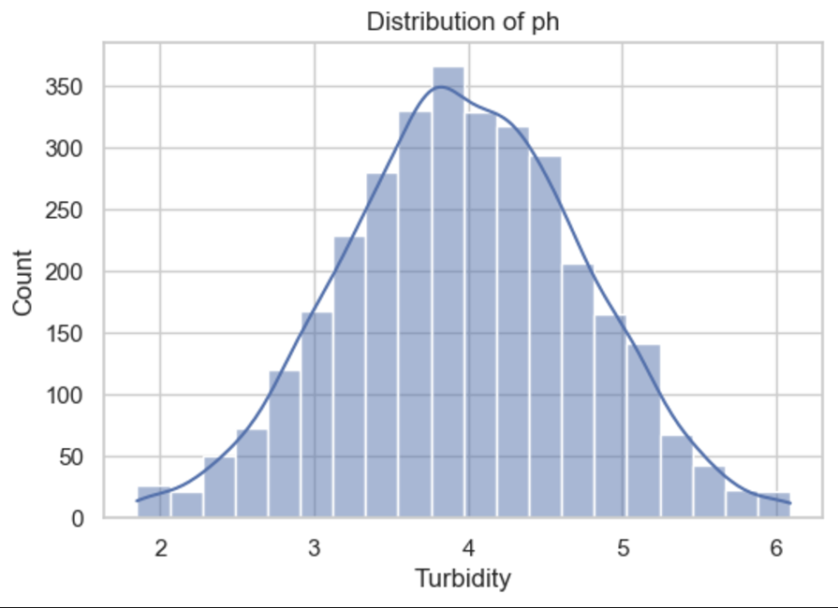
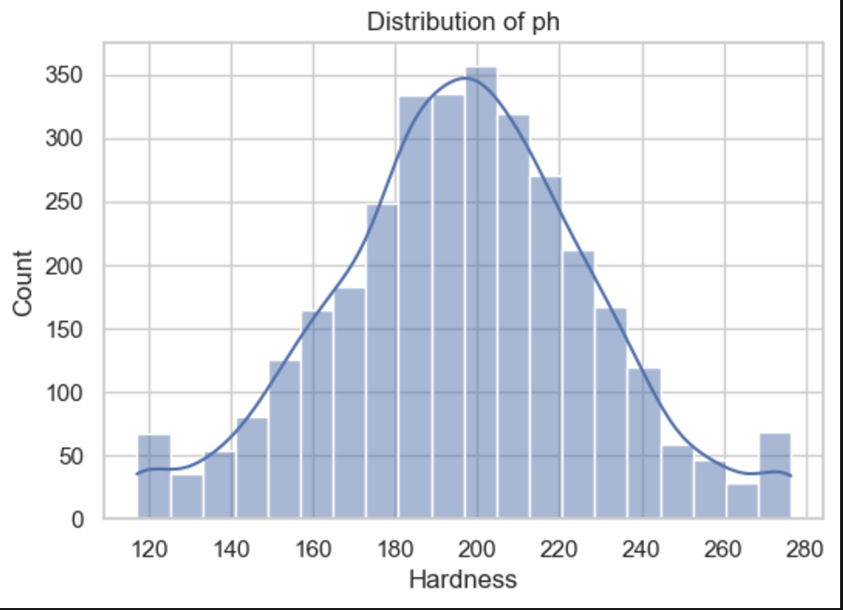
Distribution

Slide 8
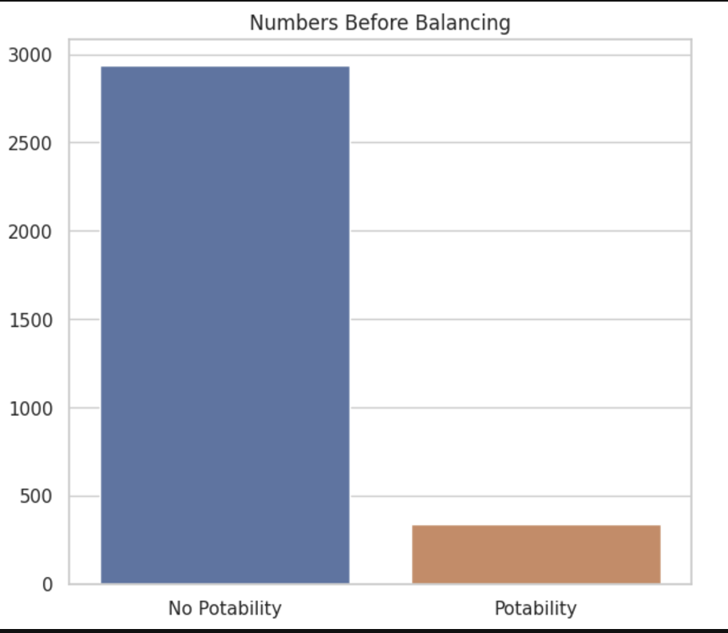
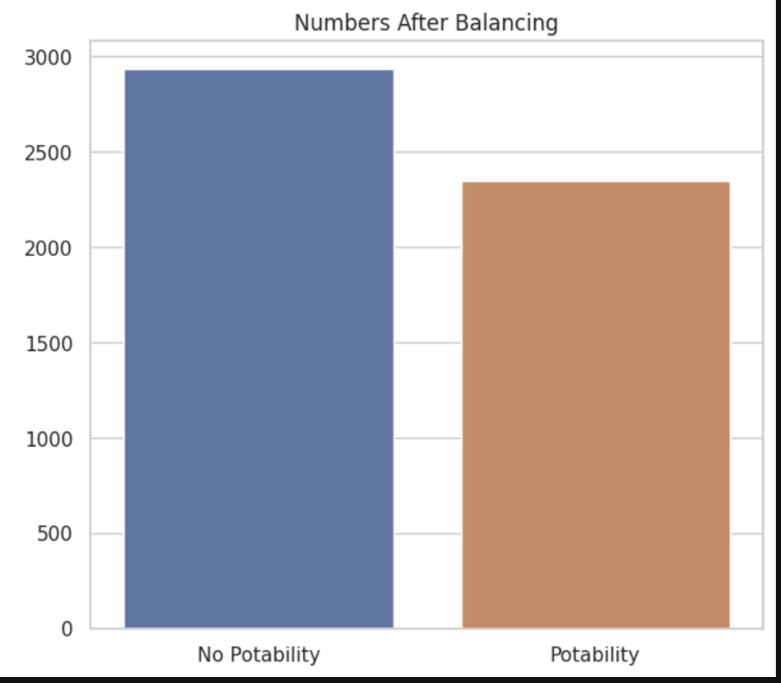
Balancing Dependent Feature

Slide 9
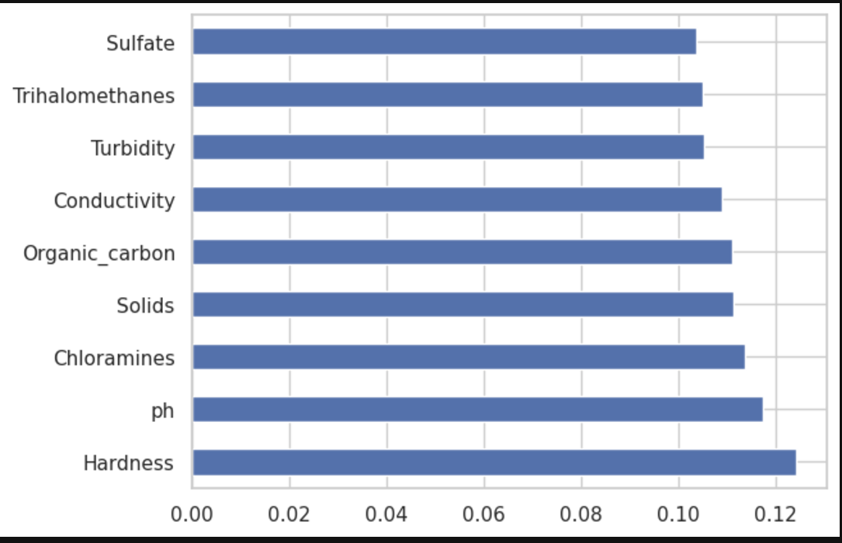
Feature Importance
The bar chart from the feature importance analysis via the ExtraTreesClassifier shows 'Hardness' as the most significant predictor for potability, while 'Sulfate' has the least importance. This suggests focusing on 'Hardness' in predictive modeling and potential water quality interventions.

Slide 10
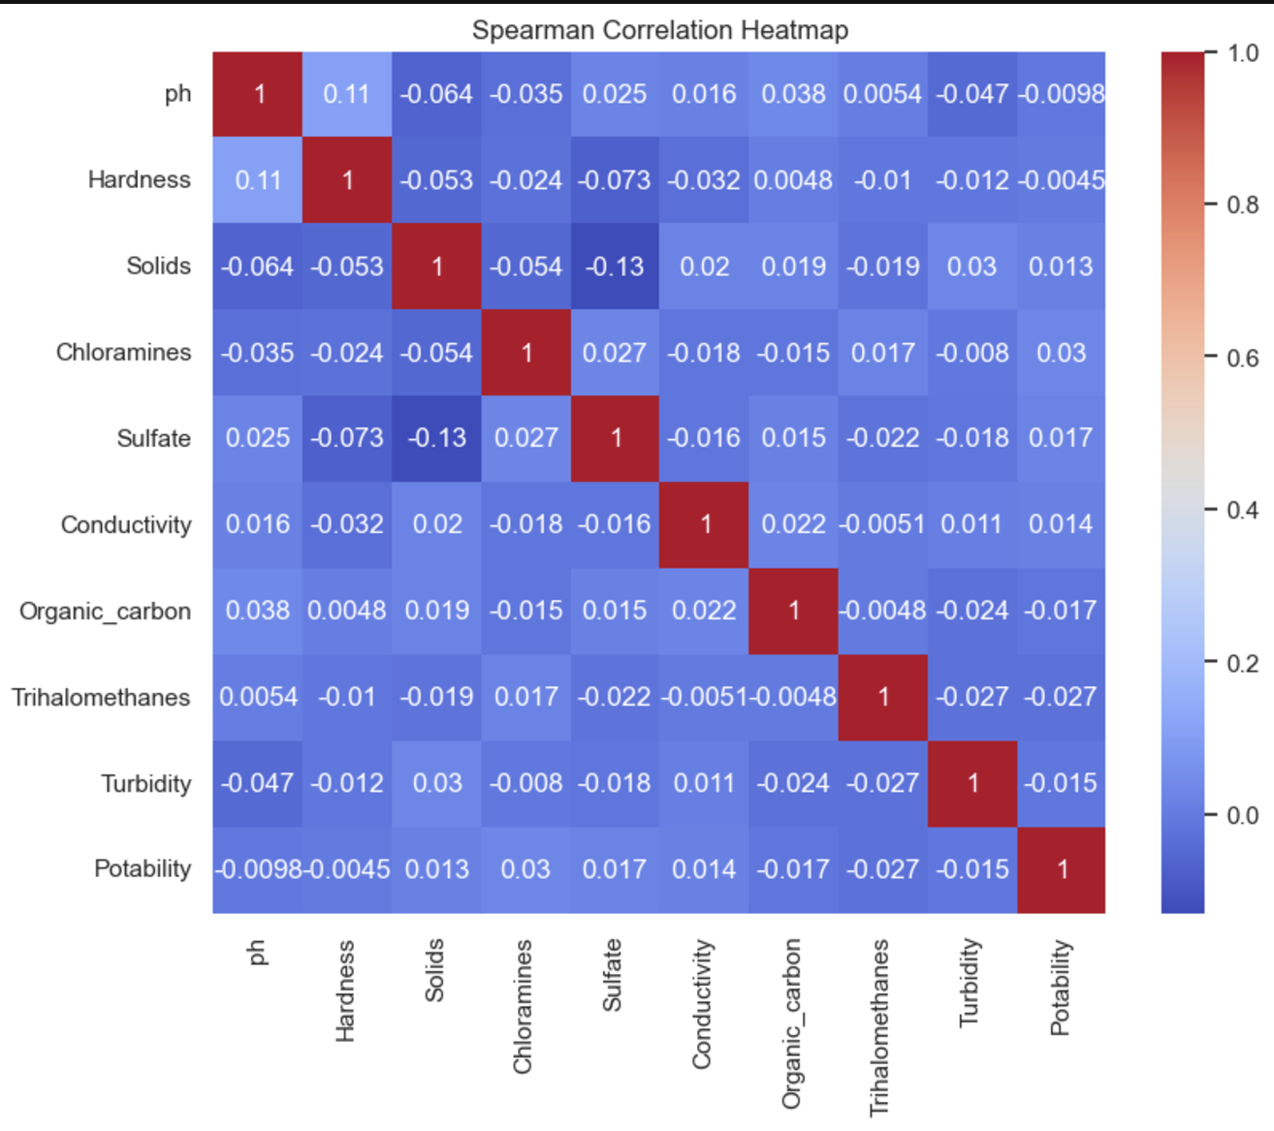
Correlation

Slide 11
Conclusion
In this comprehensive analysis of water potability, we have utilized various machine learning models to predict whether water can be deemed potable based on several physicochemical features. Our exploratory data analysis revealed key insights into the relationships between features like pH, hardness, chloramines, sulfates, and others with the target variable of potability.
The dataset’s imbalance was addressed using a combination of SMOTE and random undersampling techniques, which helped to mitigate the bias towards the non-potable class and allowed for a more generalized learning by the models

